Slide 1
Technology neutralisty vs decide and provide

Slide 2
https://www.itf-oecd.org/sites/default/files/docs/decarbonising-europes-trucks-minimise-cost-uncertainty.pdf
winners and closing the door to specific technological pathways and instead leave industry and market forces to choose how to meet targets in an efficient, cost-optimal way. Technologies develop quickly, as does the understanding of their relative pros and cons. Policies that are agnostic about technologies can be resilient to technological change. However, there are two fundamental limitations to technology-neutral policies: The first is in an uncertain technological context, where the financial risks are too large for market forces to act alone in adopting new technologies. This is particularly the case when significant infrastructure investments are required. In such cases, a government may be called on to provide support in the form of infrastructure investment. Government budgets are limited, meaning that only a selection of the most promising options can be funded, which can “lock-in” specific technology options. The second limitation to technology neutrality is in a time-limited context, where market forces alone will struggle to adopt technologies at the speed necessary to meet targets. Meeting aggressive GHG emission reduction targets by 2050 will require additional policy intervention, and remaining agnostic about technologies risks postponing action on decarbonisation. The implications of choosing a technology that helps to reach climate targets but that, in the long term, is not “optimal” may be less severe than not choosing any technology at all, given the looming impacts that climate change will impose upon the global economy. Technologies develop quickly, and governments are rightfully wary about committing to specific options in an uncertain technological environment. However, are technologies likely to develop quickly enough to make an appreciable difference to the choice of preferred technology, and is it worth postponing decisions? This report aims to shed light on potential technological pathways to help prioritise policy actions and unlock action to promote ZEVs. The total cost of ownership (TCO) is one of the most important metrics influencing trucking companies’ purchase decisions and the adoption of new technologies in the commercial vehicle sector. The TCO is the sum of all expenses over the ownership period of a vehicle and includes vehicle purchase costs, financing, residual value and the cost of operation. This analysis investigates the TCO of the three most prominent zero-emission vehicle technologies for the heavy-duty vehicle sector and compares them to conventional diesel vehicles. The novelty of this analysis isthe assessment of multiple vehicle technologies across a wide range of vehicle classes, range requirements and possible futures. Particular emphasis is placed on the uncertainty associated with each technology to answer the following questions: • Which technologies are most likely to reach TCO parity with conventional diesel vehicles? • When might TCO parity be reached? • How does TCO parity differ between vehicle classes and market segments? • What degree of certainty can be placed in the results? How might further actions by government or industry reduce uncertainty?’
Interesting text from itf on this related to trucks.

Slide 3
Cont.
Zero-emission vehicles are set to be cost-competitive with conventional ICEVs before 2040 without policy support. They will be competitive in all vehicle size segments, ranging from the smallest 7.5-tonne rigid trucks to the largest 40-tonne tractor-trailers. However, the year that ZEVs become cost-competitive with ICEVs varies by size segment and daily mileage needs. The smallest vehicles, with high daily mileage and a reliance on depot charging, already had the potential in 2022 to reach TCO parity with diesel vehicles in the range of futures considered in this analysis. Larger vehicle size segments, which typically travel longer distances, are likely to be cost-competitive with ICEVs by around 2037 without policy support. BEVs and ERSVs have the greatest promise to be cost-competitive with conventional diesel ICEVs in the European vehicle segments explored in this analysis. This is predominantly due to their higher energy efficiencies, which keep operational costs low and offset higher upfront purchase costs. Further detailed assessments of the relative merits of BEVs and ERSVs are needed to understand which technology can offer the most significant financial and CO2 emissions savings, while accounting for real-world constraints. Technology-neutral policies that avoid closing the door to either technology are warranted until it is clear that policy objectives (e.g. GHG emission reductions) could be better achieved by one over the other. In the wide range of uncertainty explored in this analysis, hydrogen FCEVs are not able to compete significantly with other vehicle technologies. FCEVs would only be cost competitive in a small number of edge cases, with highly ambitious hydrogen fuel costs below EUR 2.5/kgH2 (at the pump) and conservative scenarios for other technologies. This lack of cost-competitiveness across the majority of the European market means that achieving the necessary economies of scale in vehicle production to bring down vehicle purchase prices and ensure high utilisation of refuelling infrastructure is likely to remain a challenge for FCEVs. Policy measures are essential to help accelerate the adoption of ZEVs. Effective measures include purchase subsidies, carbon taxation and low-interest-rate loans to reduce vehicle financing costs associated with vehicle purchase. These policies would help shift the range of uncertainty on the adoption of ZEVs, kickstarting economies of scale of production and opening possibilities for ZEVs to be competitive with diesel vehicles before 2030.

Slide 4
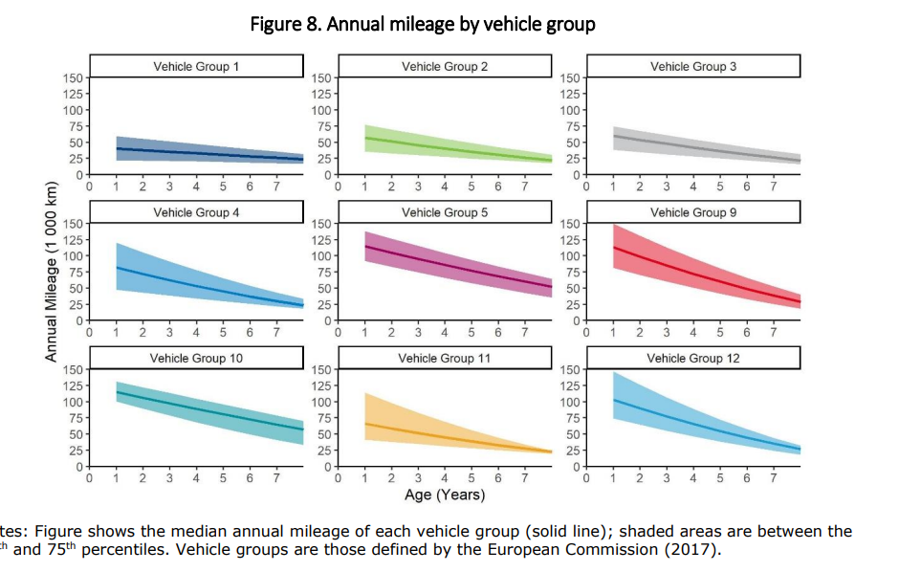
Cont.

